Slide 1
Chapter 8 Advanced Counting Techniques
8.1 Recurrence Relations
8.2 Solving Linear Recurrence Relations
8.4 Generating Functions
8.5 Inclusion-Exclusion
8.6 Applications of Inclusion-Exclusion

Slide 2

8.5 Inclusion-exclusion
Recall:
The principle of Inclusion-exclusion
mathematical induction
Show that an element in the union is counted exactly once by the right-hand side of the equation
For the union of three finite sets:
For the union of n finite sets:

Slide 3


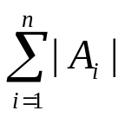


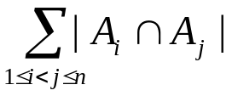
8.5 Inclusion-exclusion
Proof:
Suppose that a is an element of exactly r of the sets
where .
This element is counted times by .
This element is counted times by .
…
Thus, it is counted exactly
= 1
Why ?
Since (1-1)^{r}=0

Slide 4
8.5 Inclusion-exclusion
〖Example 1〗 Suppose that there are 1807 freshmen at your school. Of these, 453 are taking a course in computer science, 567 are taking a course in mathematics, and 299 are taking courses in both computer science and mathematics. How many are not taking a course either in computer science or in mathematics?
|U|=1807
A
A∩B B
|A|=453
|B|=567
| A∩B |=299

Slide 5
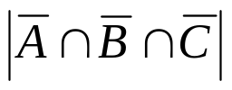


8.5 Inclusion-exclusion
〖Example 2〗How many positive integers not exceeding 1000 that are not divisible by 5, 6 or 8?
Solution:
U: the set of positive integers not exceeding 1000
A: the set of positive integers not exceeding 1000 that are divisible by 5,
B: the set of positive integers not exceeding 1000 that are divisible by 6,
C: the set of positive integers not exceeding 1000 that are divisible by 8.

Slide 6

8.5 Inclusion-exclusion
〖Example 3〗How many permutations of the 26 letters of the English alphabet do not contain any of the strings fish, rat or bird?
Solution:
U: the set of permutations of the 26 letters
A: the set of permutations of the 26 letters containing fish,
B: the set of permutations of the 26 letters containing rat,
C: the set of permutations of the 26 letters containing bird.

Slide 7
Chapter 8 Advanced Counting Techniques
8.1 Recurrence Relations
8.2 Solving Linear Recurrence Relations
8.4 Generating Functions
8.5 Inclusion-Exclusion
8.6 Applications of Inclusion-Exclusion

Slide 8





8.6 Applications of Inclusion-Exclusion
1. An alternative form of inclusion-exclusion
Problems that ask for the number of elements in a set that have none of n properties
.
Let be the subset containing the elements that have property .
----The number of elements with none of the properties .
From the inclusion-exclusion principle, we see that

Slide 9














8.6 Applications of Inclusion-Exclusion
〖Example 1〗How many solutions does have, where are nonnegative integers with ?
Solution:
Let a solution have property is , property is , property is .
The number of solutions is

Slide 10
8.6 Applications of Inclusion-Exclusion
2. The sieve of Eratosthenes
〖Example 2〗Find the number of primes not exceeding a specified positive integer.
Take 100 for example.
Solution:
A composite integer is divisible by a prime not exceeding
its square root.
Composite integer not exceeding 100 must have a prime
factor not exceeding 10.
Since the only primes less than 10 are 2,3,5,7, the primes
not exceeding 100 are these four primes and the positive
integers greater than 1 and not exceeding 100 that are
divisible by none of 2,3,5,7.

Slide 11


8.6 Applications of Inclusion-Exclusion
P₁: the property that an integer is divisible by 2
P₂: the property that an integer is divisible by 3
P₃: the property that an integer is divisible by 5
P₄: the property that an integer is divisible by 7
The number of primes not exceeding positive integer 100 is
⎣100/2⎦
⎣100/(2×3)⎦
99
⎣100/(2×3 ×5)⎦
⎣100/(2×3 ×5 ×7)⎦

Slide 12
8.6 Applications of Inclusion-Exclusion
The sieve of Eratoshenes -1
1 2 3 4 5 6 7 8 9 10
11 12 13 14 15 16 17 18 19 20
21 22 23 24 25 26 27 28 29 30
31 32 33 34 35 36 37 38 39 40
41 42 43 44 45 46 47 48 49 50
51 52 53 54 55 56 57 58 59 60
61 62 63 64 65 66 67 68 69 70
71 72 73 74 75 76 77 78 79 80
81 82 83 84 85 86 87 88 89 90
91 92 93 94 95 96 97 98 99 100

Slide 13
8.6 Applications of Inclusion-Exclusion
The sieve of Eratoshenes -1
1 2 3 4 5 6 7 8 9 10
11 12 13 14 15 16 17 18 19 20
21 22 23 24 25 26 27 28 29 30
31 32 33 34 35 36 37 38 39 40
41 42 43 44 45 46 47 48 49 50
51 52 53 54 55 56 57 58 59 60
61 62 63 64 65 66 67 68 69 70
71 72 73 74 75 76 77 78 79 80
81 82 83 84 85 86 87 88 89 90
91 92 93 94 95 96 97 98 99 100

Slide 14
8.6 Applications of Inclusion-Exclusion
The sieve of Eratoshenes -1
1 2 3 4 5 6 7 8 9 10
11 12 13 14 15 16 17 18 19 20
21 22 23 24 25 26 27 28 29 30
31 32 33 34 35 36 37 38 39 40
41 42 43 44 45 46 47 48 49 50
51 52 53 54 55 56 57 58 59 60
61 62 63 64 65 66 67 68 69 70
71 72 73 74 75 76 77 78 79 80
81 82 83 84 85 86 87 88 89 90
91 92 93 94 95 96 97 98 99 100

Slide 15
8.6 Applications of Inclusion-Exclusion
The sieve of Eratoshenes -1
1 2 3 4 5 6 7 8 9 10
11 12 13 14 15 16 17 18 19 20
21 22 23 24 25 26 27 28 29 30
31 32 33 34 35 36 37 38 39 40
41 42 43 44 45 46 47 48 49 50
51 52 53 54 55 56 57 58 59 60
61 62 63 64 65 66 67 68 69 70
71 72 73 74 75 76 77 78 79 80
81 82 83 84 85 86 87 88 89 90
91 92 93 94 95 96 97 98 99 100

Slide 16
8.6 Applications of Inclusion-Exclusion
The sieve of Eratoshenes -1
1 2 3 4 5 6 7 8 9 10
11 12 13 14 15 16 17 18 19 20
21 22 23 24 25 26 27 28 29 30
31 32 33 34 35 36 37 38 39 40
41 42 43 44 45 46 47 48 49 50
51 52 53 54 55 56 57 58 59 60
61 62 63 64 65 66 67 68 69 70
71 72 73 74 75 76 77 78 79 80
81 82 83 84 85 86 87 88 89 90
91 92 93 94 95 96 97 98 99 100

Slide 17





8.6 Applications of Inclusion-Exclusion
3. The number of onto functions
Theorem:
Let m and n be positive integers with . Then, there are
onto functions from a set with m elements to a set with n
elements.
Proof:
Let be the property that is not in the range of the function, respectively.
Note that a function is onto if and only if it has none of the properties .

Slide 18




8.6 Applications of Inclusion-Exclusion
By the principle of inclusion-exclusion, it follows that the number of onto functions is
Applications:
  Assign m different jobs to n different employees if every employee is assigned at least one job.
  Distribute m different toys to n different children such that each child gets at least one toy.

Slide 19
8.6 Applications of Inclusion-Exclusion
4. Derangement
〖Example 3〗Count the permutations for n objects that leave no objects in their original positions.
A derangement is a permutation of objects that leaves no object in its original position.

Slide 20
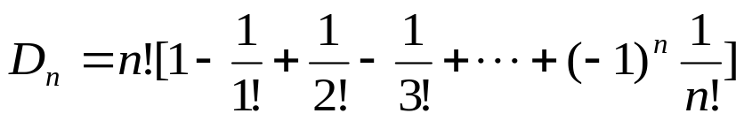

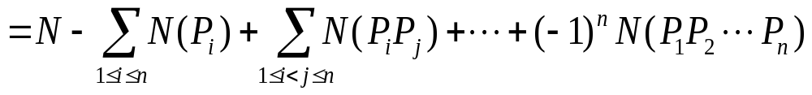
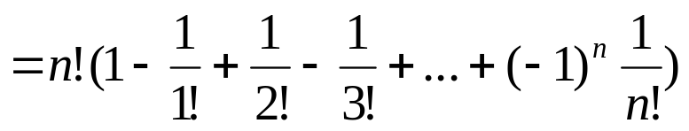
8.6 Applications of Inclusion-Exclusion
Theorem: The number of derangements of a set with n elements is
Proof:
Let a permutation have property P_{i} if it fixes element i.
The number of derangements is the number of permutations having none of the properties P_{i} for i=1, 2, …, n.

Slide 21
8.6 Applications of Inclusion-Exclusion
Homework: (Due on May 11)
Ver.8
Sec. 8.5 7, 10, 20
Sec. 8.6 6, 11, 16
Ver. 7
Sec. 8.5 7, 10, 18
Sec. 8.6 6, 11, 16

